Slide 1
Who will feed our future? A systematic literature review of new and beginning farmers

Slide 2
Background information
New and beginning farmers are increasing
Organic sales doubled
23% more female producers
Direct-to-consumer sales doubled
Notes:
Who do you visualize when someone says the word “farmer?” Is it an old man driving his tractor on a 2-land road that you’re really annoyed you can’t pass? Is it your grandfather? Is it those same faces you see at the farmer’s market week after week? The farm where you went on a haunted hay ride? It could be any of these, and the face of farming is constantly changing. This was solidified when looking at the trends in the 2012 versus 2017 Census of Agriculture. There are more new and beginning farmers, direct-to-consumer sales doubled, organic sales doubled, and the number of female producers increased by 23%. These changes could mean people on farms taking different decision-making roles as they are newer and more female. The increased market share of direct-to-consumer sales could mean that local food systems are gaining popularity, perhaps more so in organics as well. The purpose of this systematic literature review was to determine the characteristics of the new and beginning organic farmers who support local food systems.

Slide 3
What is a systematic literature review?
Yes: Transparent protocol
Yes: Exhaustive seach
Yes: Conclusions contribute to theory, practice, future research
No: Literature review for a publication
Notes:
A systematic literature review is an exhaustive search of available literature, laying out each step so that it is replicable, and drawing robust conclusions. It is not a literature review a researcher would write for a journal article which follows a series of logical ideas to set up the rest of the project.

Slide 4
Systematic literature review process
Notes:
This figure shows the review process from the scoping and planning stages to the socio-ecological analysis. We ended up with 21 articles whose conclusions we analyzed according to a socio-ecological model.

Slide 5
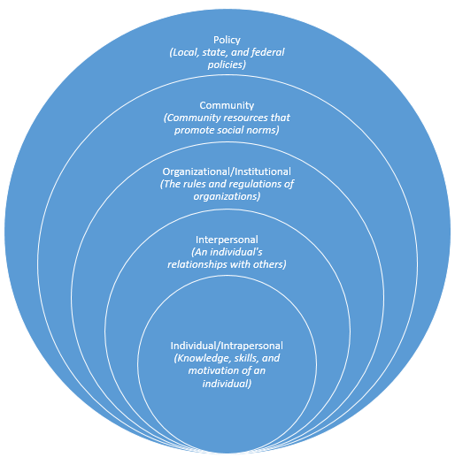
Analysis: Socio-Ecological Model
Notes:
We analyzed the conclusions of the 21 articles based on a socio-ecological model, which identifies drivers in an individual’s world that contribute to decision-making. The analysis focused on characteristics that apply to farmers and starting a farm. For example, for the intrapersonal layer we looked for farming knowledge and skills, identity, finances and values. Interpersonal includes a farmer’s relationships with their families and social support network members. Institutional includes how the farmer runs their farm and interacts with employees. Community includes farmer organizations and educational opportunities. Policy includes those that impact farmers like organic certification, cottage laws, urban zoning and land use policy.

Slide 6
Results

Slide 7
Notes:
Here are the articles by year of publication. Our sample size is small, but it’s worth pointing out that 11 out of 21 articles are from just the last 3 years.

Slide 8
Journal name | Frequency | Scimago journal ranking
Journal of Agriculture, Food Systems, and Community Development | 3 | No ranking available
Agriculture and Human Values | 1 | Q1
Journal of Agromedicine | 1 | Q2
Agroecology and Sustainable Food Systems | 1 | Q1
British Food Journal | 1 | Q1
Community Mental Health Journal | 1 | Q2
Economic Anthropology | 1 | No ranking available
Gender, Place & Culture | 2 | Q1
Renewable Agriculture and Food Systems | 1 | Q1
Rural Sociology | 5 | Q1
Journal of Rural Studies | 1 | Q1
Society & Natural Resources | 3 | Q1
Notes:
No one journal stood out, though with 5 articles Rural Sociology technically makes up nearly 25% of the articles. Journals ranked by Scimago were all in the top 50% or better in their discipline.

Slide 9
Notes:
All 21 articles included 87 key words, which were then grouped into categories. Keyword groups can tell us what the larger literature base is talking out,. They keyword groups indicate that the literature is about farmers farming of course, but also taking into account the perspective we study them from, the health and well-being of individuals and communities, accessing land, economic conditions, a focus on certain geographical areas, and social changes coming from farmers.

Slide 10
Study geography
Level | Frequency | Article codesª
Single state | 11 | 1, 3, 6, 8, 10, 11, 12, 15, 18, 19, 20
Multi-state | 3 | 7, 14, 17
Regional | 4 | 2, 9, 13, 21
National | 3 | 4, 5, 16
Notes:
Most studies focused on a single state, and some of those were actually just one city, maybe a couple cities, not necessarily state-wide. Studies focused on the West and Northeast.

Slide 11
Concepts and analytical categories by layer
Notes:
Articles focused mostly on the intrapersonal layer of the socio-ecological model. That layer will be the most information rich compared to interpersonal and policy.

Slide 12
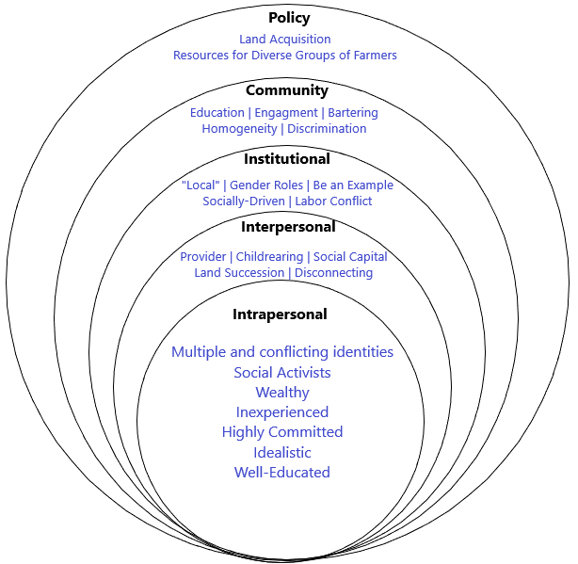
Overall Socio-Ecological Model
Notes:
Here is our socio-ecological model of new and beginning organic farmers. I analyzed and categorized all article conclusions according to socio-ecological layer. In general, farmers are socially and economically advantaged, most likely white, and well-educated. They are probably idealistic and committed. They are likely to face at least one type of identity conflict, the two prominent being woman-farmer and finances-idealism. New and beginning farmers enjoy spending time with their loved ones and value time connecting to their consumers, but have trouble separating themselves from the farm and struggle with any visualization of what will happen to their land when they retire from farming. They value providing local food to their community. They want to show others it can be done. They want to provide a living wage. In their communities, they are passionate about engaging with others, but are still racially homogenous and male dominant. Access to land is the largest barrier they face.

Slide 13
Discussion
Women and gendered work
Balancing ideals and finances
Social entrepreneurship
Notes:
Women challenges a male-dominated industry. Women fill multiple roles of caretaker, mother, plus now a farmer. Relying on men for land and income is still a barrier for women farmers, plus the long history of equipment being built for men and women struggling with that. If women focus on the non-economic rewards of farming, their increasing presence could shift decision-making toward customer satisfaction and relationships, happiness, and raising a family in a “wholesome” environment.
Identity conflict is also a large source of uncertainty for the future of farmer decision-making. When balancing making money and being environmentally and socially sustainable, balance and compromise may prove too challenging in the long run. But it’s possible that social entrepreneurship can help achieve balance.

Slide 14
Concluding remarks
White and wealthy farmers or consistent sampling bias?
New and beginning organic farmers are conflicted about adhering to their ideals versus making an adequate income.
Change isn’t “coming,” it’s happening.
Notes:
The conclusions presented here have limited generalizability since we had only 21 articles. The small sample itself indicates that this is an understudied area of research.
New and beginning organic farmers are overwhelmingly white and wealthy. Unfortunately the literature we analyzed did not provide an adequate analysis of the racial and economic homogeneity of their own samples. If this is coincidence, then researchers must address this in future studies by recruiting diverse groups of farmers. If it’s not a coincidence, then the wealth gap is also becoming a race gap.
Idealism versus making a living requires either supplementing a low income or sacrificing their commitment. This challenge is the most salient because it speaks to the long-term sustainability of the farm as a business.
If we want more women farmers, they need to be able to compete with the men. They are built differently.
There is a new generation of organic farmers, and knowing their goals, motivations and identities can help providers across sectors appeal to and recruit farmers, and be ready to meet them where they are while also building a more equitable future for farmers and provide support that encourages a socially and racially diverse farming community.

